Slide 1
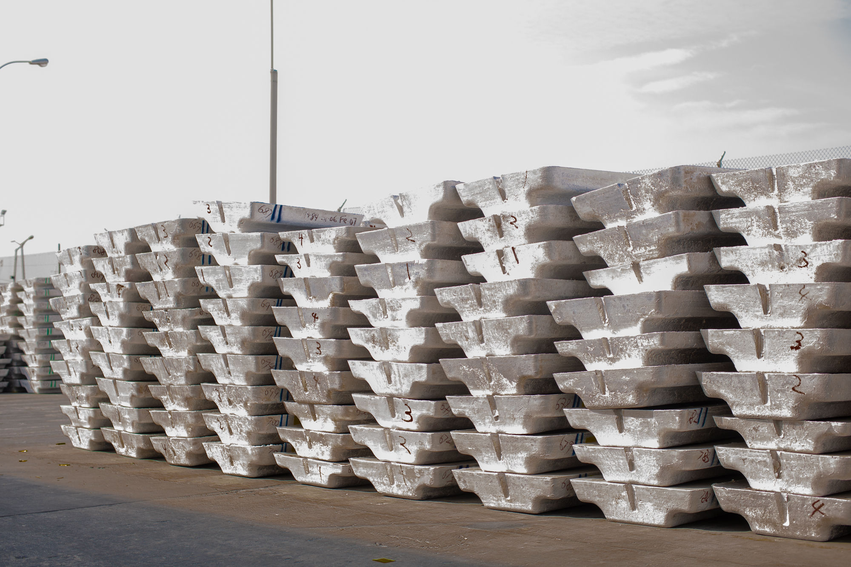

July 2025
Driving Industrial Growth Through Project Management
Karen Asafu-Adjaye
Director, Programme Management and IT - GIADEC

Slide 2
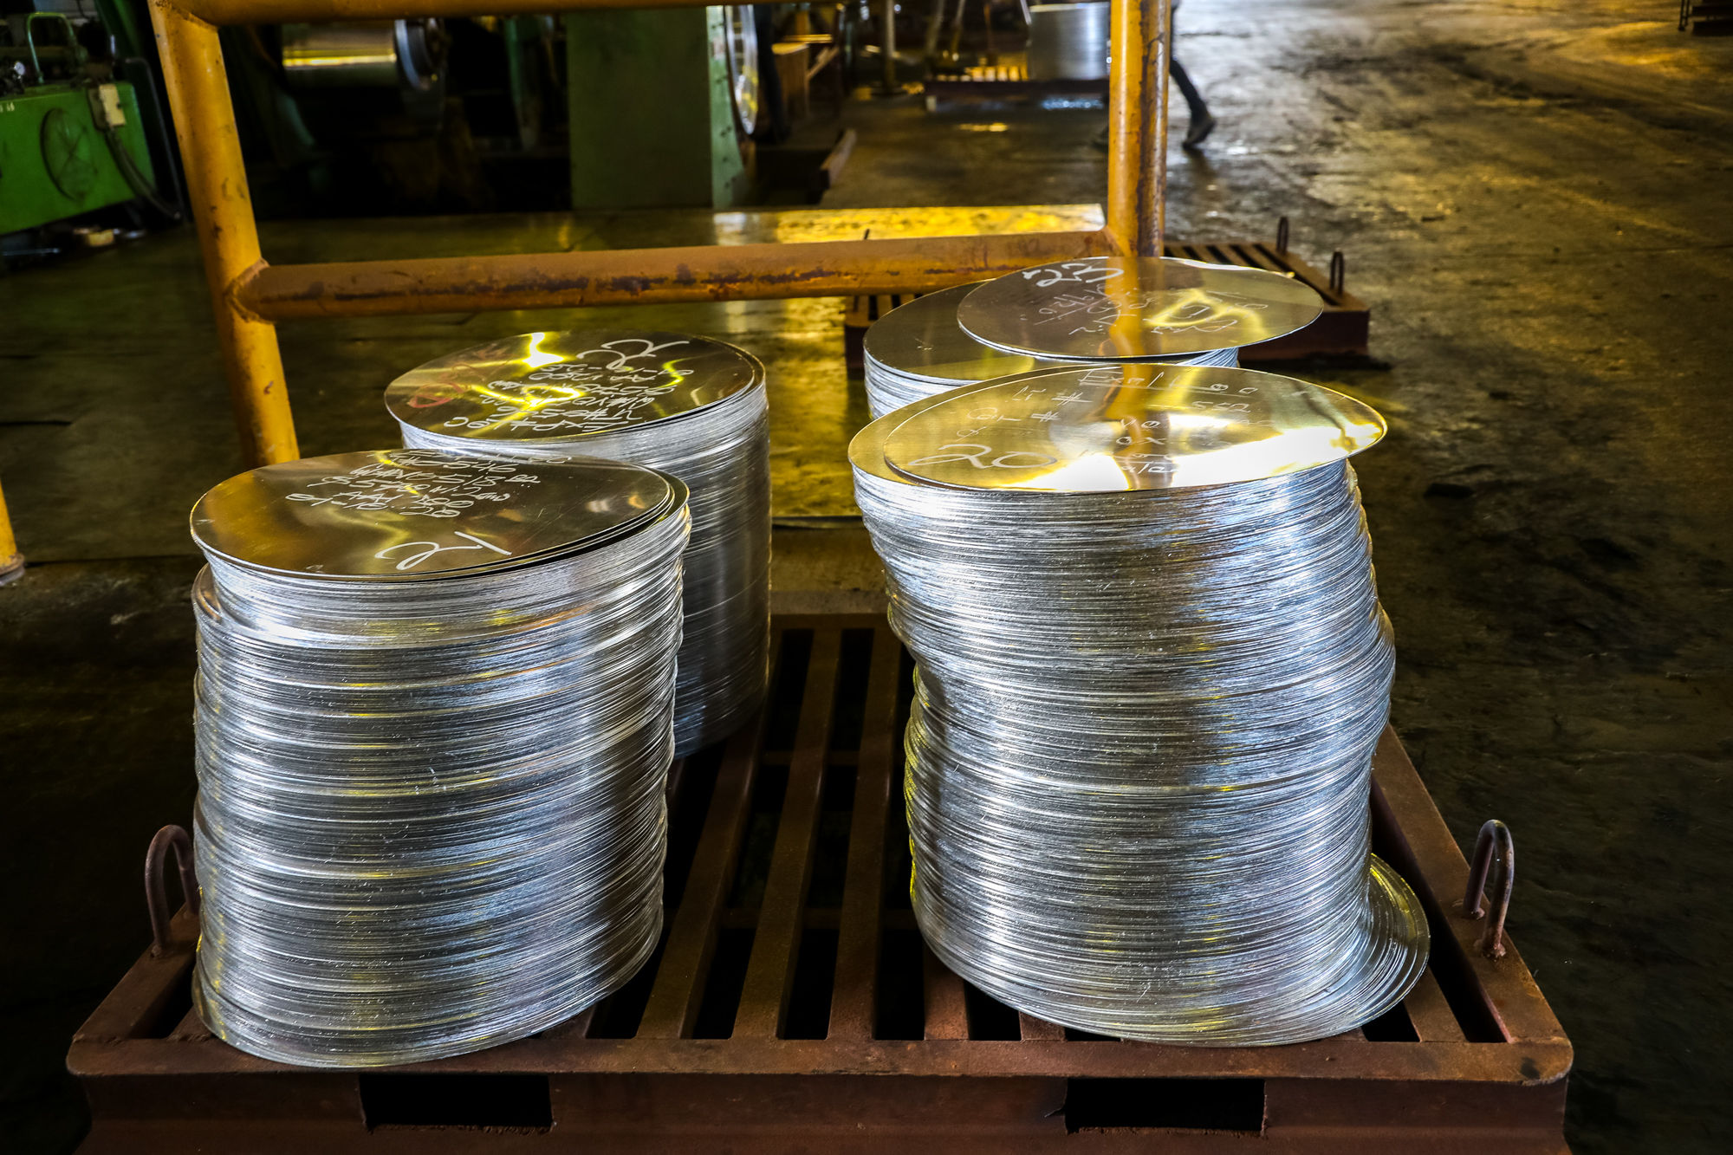
Agenda slide
Aluminium Value Chain
Industrialisation in Ghana
Ghana Integrated Aluminium Development Corporation
Project & Programme Management Insights
Recommendations

Slide 3
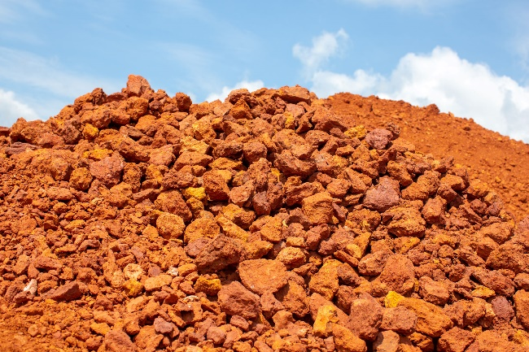
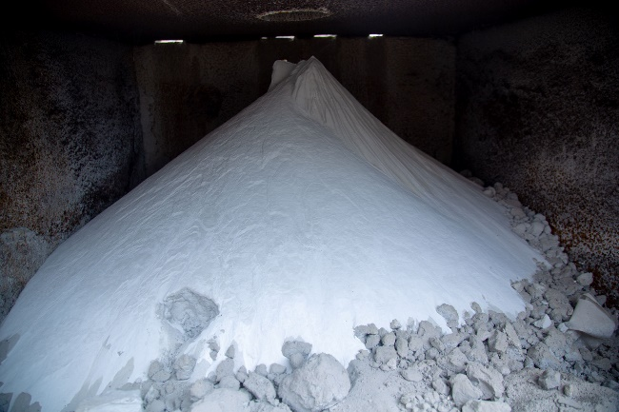
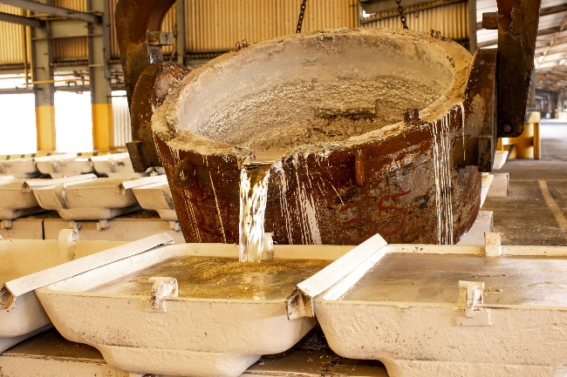
Aluminium Value Chain
1
Mining Bauxite
2
Refining Alumina
3
Smelting Aluminium
Value = $40-80/tonne
Value = $300-400/tonne
Value ~ $2,500/tonne
5 tonnes
2 tonnes
1 tonne

Slide 4
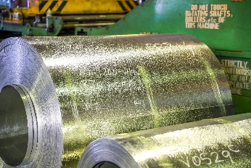
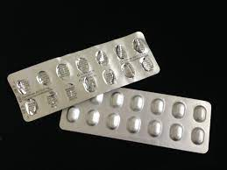
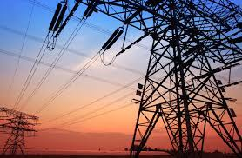
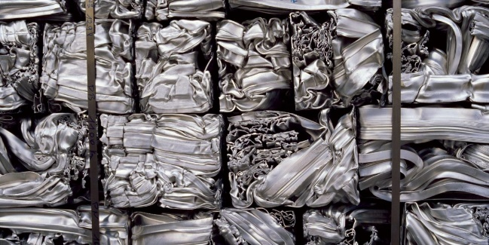
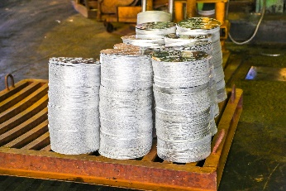

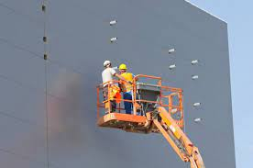
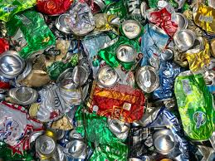
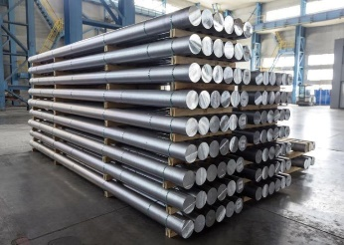

Downstream Aluminium Value Chain
It doesn’t end with aluminium smelting
4
Semi-finished Products
5
Product Manufacturing
6
Recycling / Secondary Aluminium
Semi-finished products include billets, extrusions & rolling stock
Opportunities in construction, electrical, automotive, packaging industries
Secondary aluminium requires 90% less energy than primary production

Slide 5
Current Downstream Aluminium Usage
Primary Aluminium
Imported Aluminium Products
Ghana produces about 40,000-60,000 tonnes of primary aluminium a year, and also imports about 40,000 tonnes of aluminium products each year.
There are significant opportunities for import substitution.
Other Countries
6,980
Supplied
Locally
India
31,439
Exported
China
(incl. Hong Kong)
In 2020, approximately 38,000 tonnes of aluminium was produced in Ghana
The chart above shows the sources of the ~42,000 tonnes of aluminium and aluminium products imported into Ghana in 2019.
Source: VALCO sales data
Source: Ghana Customs

Slide 6
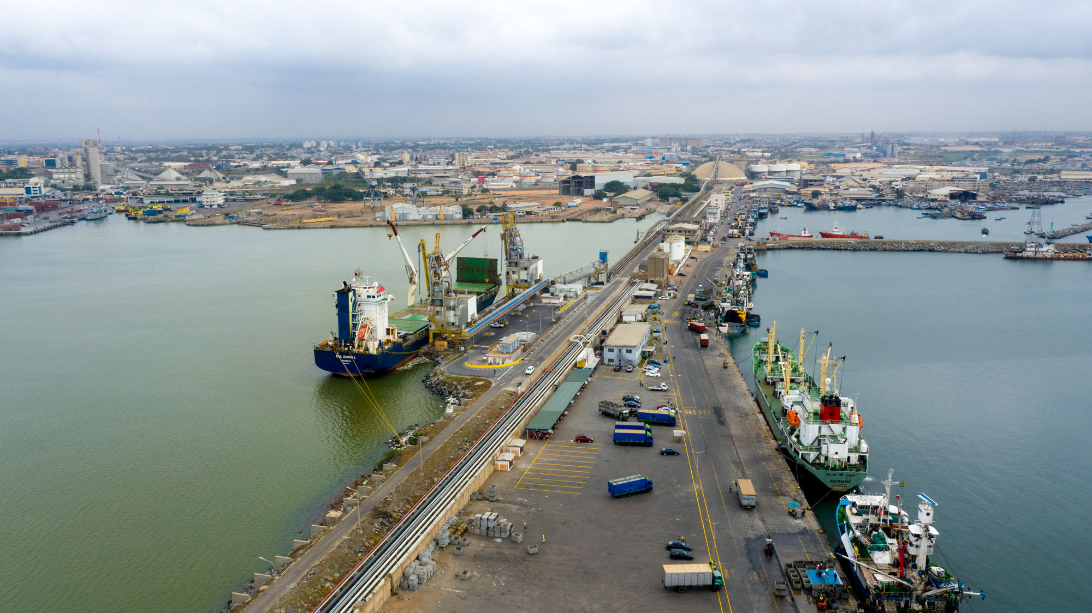
“
Industrialisation is the process of transforming the economy of a nation or region from a focus on agriculture to a reliance on manufacturing
Investopedia.com
Notes:
Includes focus on natural resources

Slide 7
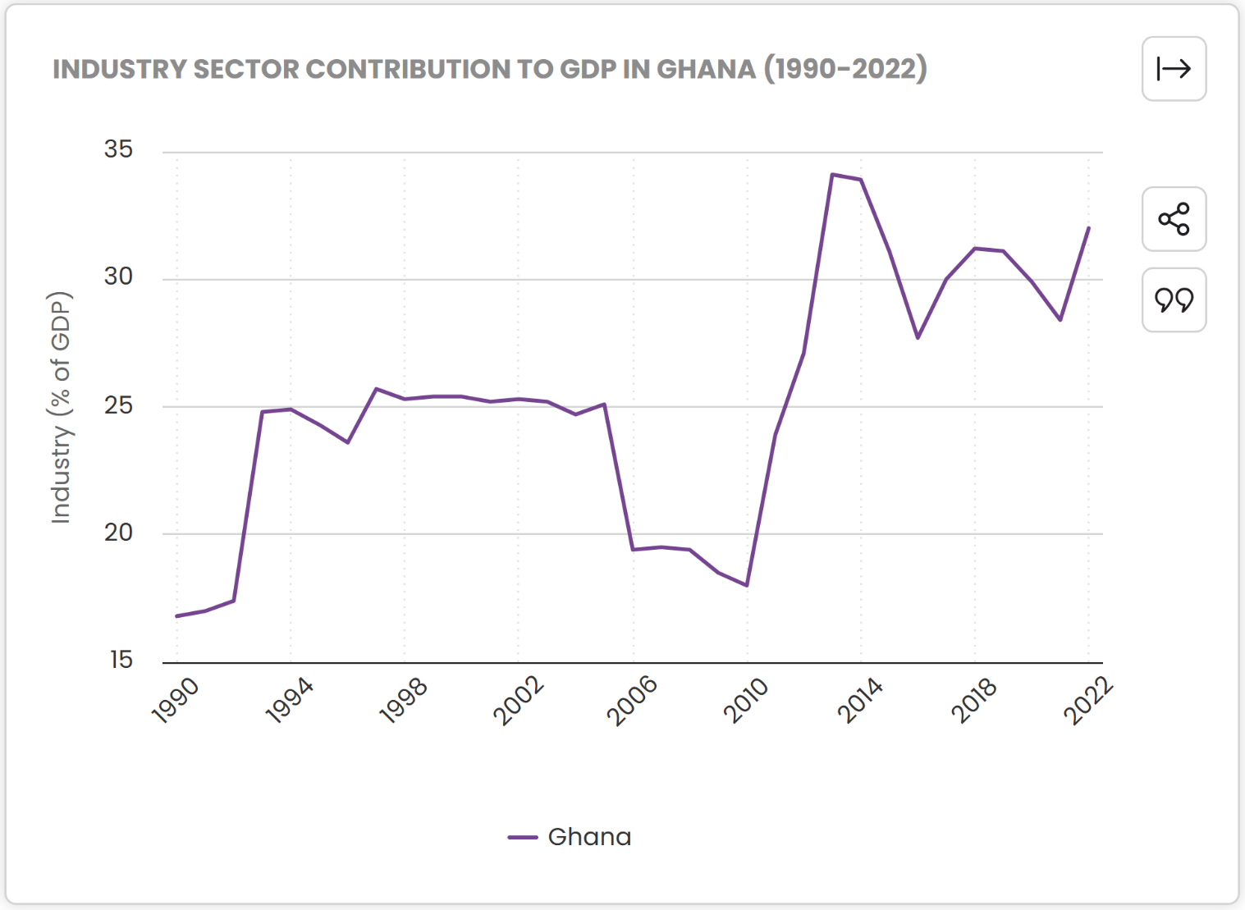
Contributions to Ghana’s GDP from Industry
Services accounts for approx. 47% of GDP contributions.
This is followed by industry (30%) and agriculture(23%).
Cocoa dominates agriculture sector.
Mining (particularly gold) dominates industry sector. Oil & Gas is a significant contributor.
Aluminium industry has potential to match Oil & Gas in terms of contribution to GDP.
Source: World Bank Group, 2024
Notes:
https://tgmstatbox.com/stats/ghana-industry-sector-gdp-contribution
Diversifying brings reliance – reference Vision 2057
Give Bahrain and UAE as examples of nations transformed through aluminium industry

Slide 8
Impact of Integrated Aluminium Industry on Ghana’s GDP
A fully Integrated Aluminium Industry (IAI) can boost Ghana’s GDP by up to 4.5%
Significant positive spillovers in construction, utilities, and manufacturing sectors.
Potentially larger economic impact than Oil & Gas industry.
At least 43,000 direct and indirect jobs created in “upstream” industry.
Additional 20,000 jobs downstream.
Potential $2B annual contribution to GDP expected.
Year 1 Year 2 Year 3 Year 4 Year 5 Year 6
Source: Economic and Social Impact Analyses of the IAI Project, Dr Theo Acheampong, 2023

Slide 9
Africa’s Aluminium Industry
Ghana is the African country closest to establishing an Integrated Aluminium Industry
Guinea
Estimated bauxite reserves of 7.4B tonnes. Annual production 85M tonnes (2021).
Friguia Refinery – 650,000 tonnes capacity. Feasibility study for smelter ongoing.
Source: https://rusal.ru, https://www.statista.com
Egypt
EgyptAlum Smelter with capacity of 320,000 tonnes.
Source: https://www.egyptalum.com.eg/
Sierra Leone
Estimated 60M tonnes bauxite reserves (2018). Produces 1.3M tonnes per annum (2020).
Source: https://vimetcobauxite.com/, https://www.statista.com
Cameroon
Alucam Smelter with capacity of 100,000. Estimated bauxite reserves of 1B tonnes. Planned mine and refinery operations.
Source: https://www.alucam.cm/
Cote d’Ivoire
Estimated reserves: 35M tonnes
Production: 380,000 tonnes (2020)
Source: https://oxfordbusinessgroup.com/, https://www.statista.com
Tanzania
Produces small volumes of bauxite annually – 26,000 tonnes in 2020
Source: https://www.statista.com/
Ghana
Estimated resource of 900M tonnes.
VALCO Smelter with capacity of 200,000 tonnes. Two planned alumina refineries.
Mozambique
Estimated bauxite resources of 2m. Produces under 10,000 tonnes annually.
Two smelters with combined capacity of 580,000
Source: https://pubs.usgs.gov/
Key:
operational
planned
Bauxite mine
Nigeria
ALSCON Smelter not currently operational – capacity of 120,000
Source: https://rusal.ru
South Africa
Richard’s Bay Smelter with capacity of 720,000 tonnes
Source: https://www.statista.com
Refinery
Smelter

Slide 10
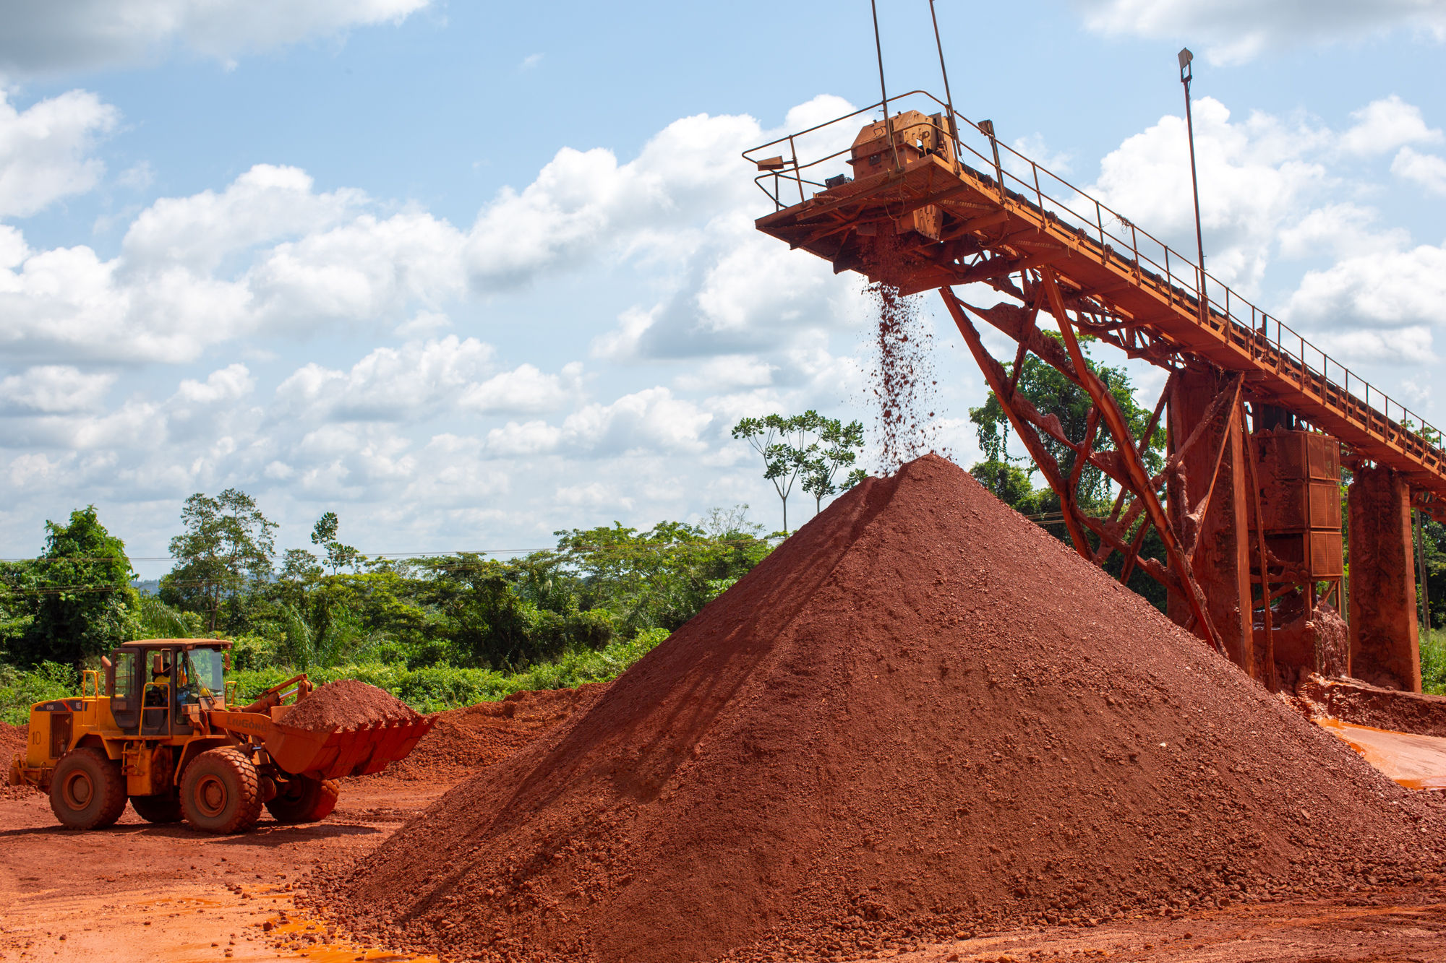
Ghana’s Bauxite & Aluminium History

Slide 11
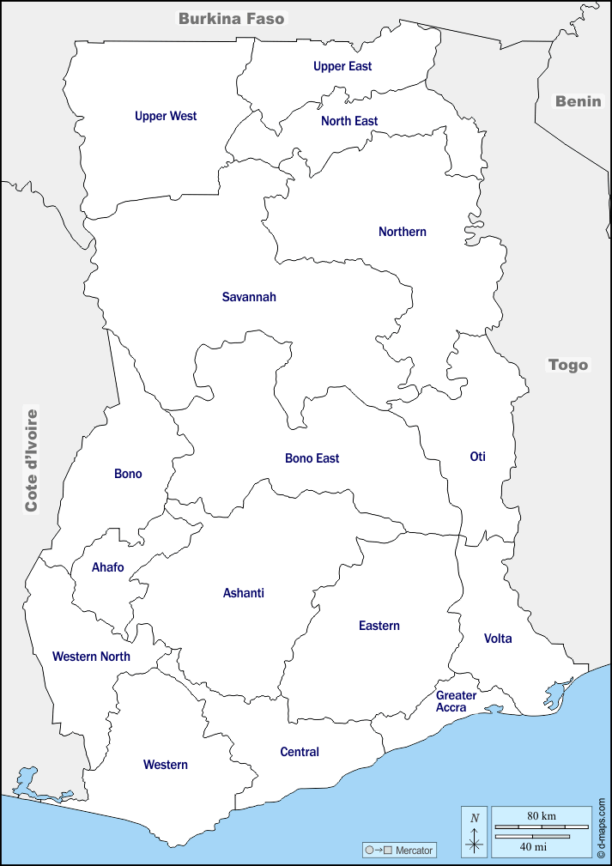



Ghana’s Bauxite and Aluminium History
Bauxite has been mined and exported since the 1940s
GIADEC established in 2018 to develop and promote a fully Integrated Aluminium Industry
Bauxite Resources - Kyebi
~160 million tonnes of bauxite at Kyebi
Bauxite Resources - Nyinahin
~ 700 million tonnes of bauxite in Nyinahin
Aluminium smelter - Tema
200k capacity aluminium smelter, Valco, commissioned in 1967.
100% owned by Government of Ghana through GIADEC.
Current production of ~50K per annum.
Uses hydro power
Bauxite mine - Awaso
Operated by Ghana Bauxite Company since 1942.

Slide 12
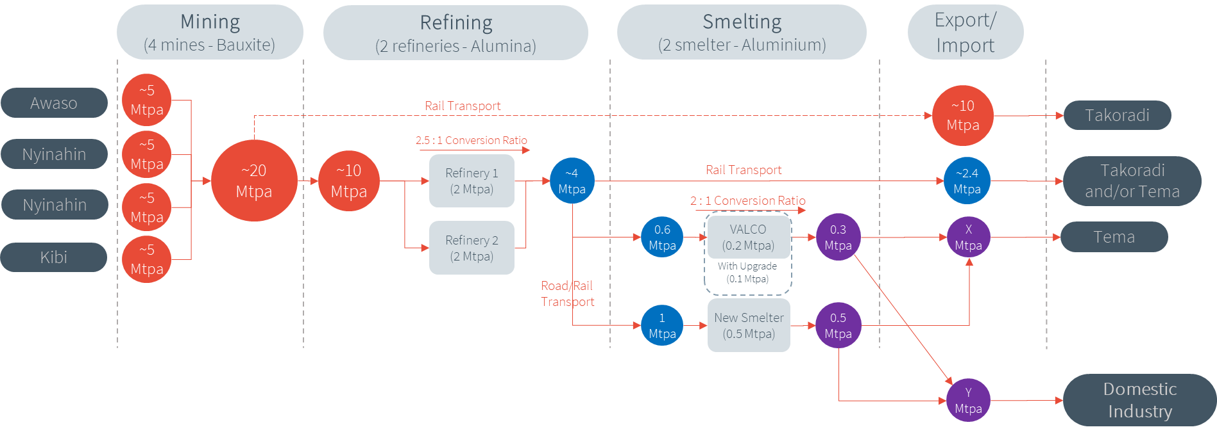






Future State of Ghana’s Integrated Aluminium Industry
A Master Plan was established to guide how the IAI would be developed
Benefits
Jobs
Infrastructure
Contribution to GDP
Value addition
People development
Export
Industrialised economy
Underpinned by
Railways
Ports & Harbour
Regulatory framework
Environmental protection
People & Community

Slide 13
GIADEC’s Project Management Office
Improving probability of project success
Purpose of PMO
To increase the probability of success of GIADEC projects by providing centralised and coordinated management of all internal and external projects.
Functions Include:
Centralised & standardised management
Greater visibility and control
Alignment with corporate strategy
Active management of project risks
Project Manager support for each department

Slide 14
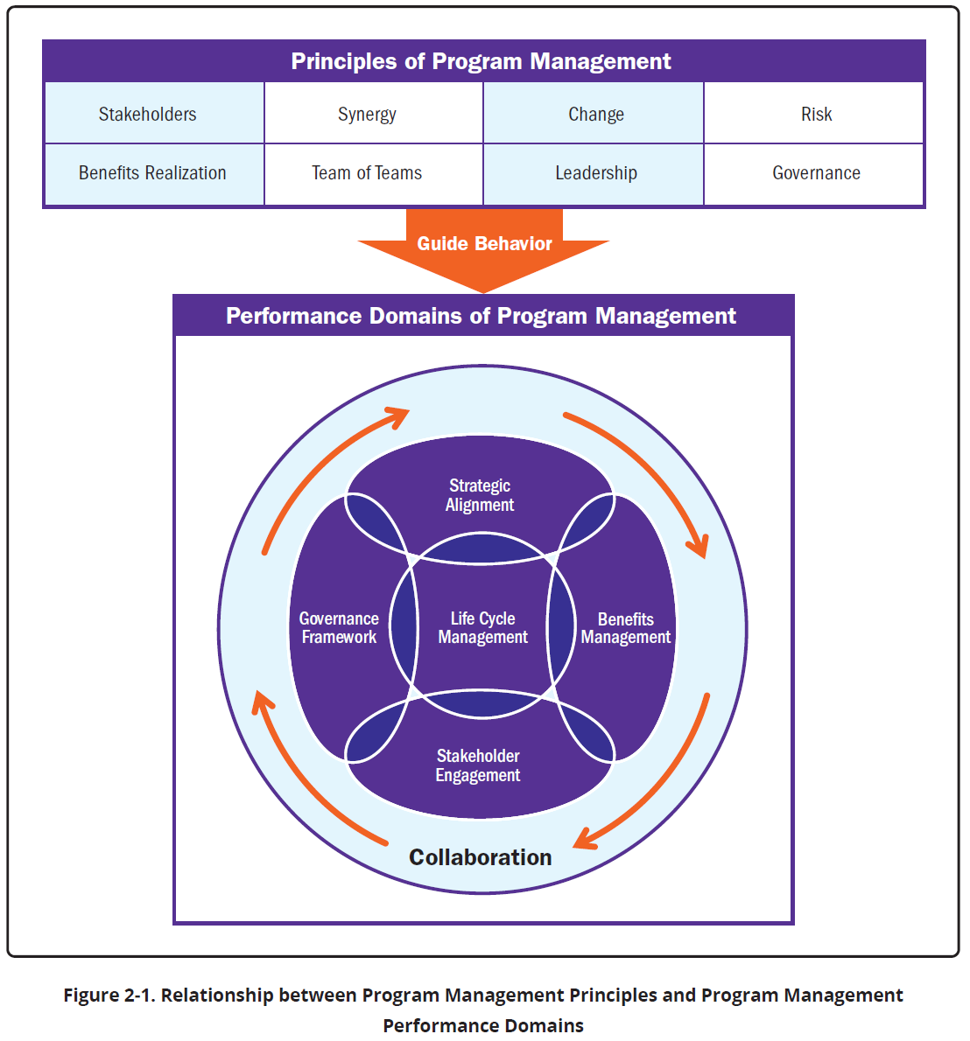
GIADEC’S PM Contribution to Ghana’s Industrialisation
GIADEC is driving Ghana’s journey toward an Integrated Aluminium Industry through robust project management, with particular emphasis on:
Benefits Realisation
Stakeholder Engagement
Risk Management
Governance
Image Source: The Standard for Programme Management, Fifth Edition

Slide 15
Benefits Realisation & Risk Management
Benefits Realisation
Commissioned study to understand social & economic impact of IAI.
Defined clear industrialisation outcomes: value addition, job creation, and local capacity building.
Aligned projects with national industrialisation goals. (Vision 2057).
Risk Management
Established a comprehensive Risk Management Framework.
Identified and mitigated key risks across:
    Social (social licence to operate, land access)
    Financial (funding delays)
    Technical (infrastructure gaps)
    Environmental (ESIA compliance)
  Embedded risk registers and mitigation plans in each project.

Slide 16
Stakeholder Engagement & Governance
Stakeholder Engagement
Mapped and segmented stakeholders across government, local communities, investors, traditional leaders, and CSOs.
Established Working Groups for key stakeholders responsible for required infrastructure – Transport & Power.
Regular community engagements through established community-based committees.
Established structured engagement plans per project.
Governance
Established a structured Programme Management Office (PMO) to oversee project delivery with clear roles and accountabilities.
Enforced project governance protocols: stage-gate reviews, reporting dashboards.
Aligned project governance with PMI standards.
Maintains executive oversight through Steering Committees and Board reporting.
Notes:
GIADEC has laid a strong project management foundation that supports credible and impactful industrial development in Ghana’s aluminium sector.

Slide 17
Recommendations
Accelerating Industrialisation through Strategic Project Delivery
Recommendation | Key Actions
1. Focus on Benefits | Define clear, measurable outcomes aligned with national development goals Track delivery and measure long-term outcomes (e.g., jobs, skills, exports).
2. Engage Stakeholders Well | Map stakeholders (government, private sector, communities, etc) Develop tailored engagement plans to build trust and manage expectations. Use engagement to shape projects.
3. Establish Strong Risk Management | Create and maintain a live risk register with clear ownership and mitigation plans. Review often!
4. Build Strong Governance Structures | Set up a Programme Management Office (PMO) to guide delivery. Define clear roles, responsibilities, and decision-making authorities. Introduce regular reviews, reporting, and performance tracking mechanisms.
5. Know When to Stop | Reassess the business case regularly Be willing to end projects that no longer add value. National priorities evolve.
6. Build PM Capacity | Promote structured, repeatable delivery across agencies Invest in training, tools, and systems

Slide 18
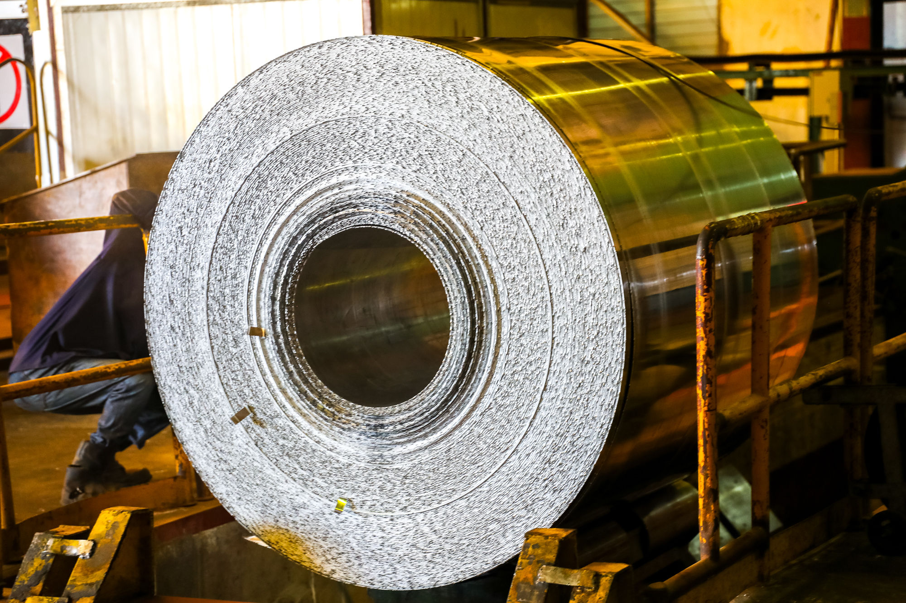





Driving Industrial Growth Through Project Management
Karen Asafu-Adjaye
Director, Programme Management and IT - GIADEC
@officialgiadec

